Slide 1

Online Book Review System
Id | Name | Batch | Group | Project
2492326 | Siddhartha Sarkar | 216 Java SL AM | 7 | Project - Online Book Review System
2492183 | Siram Vinay | 216 Java SL AM | 7
2493245 | Sivakumar M | 216 Java SL AM | 7
2492117 | Sneha B Karer | 216 Java SL AM | 7
2492344 | Somala Vedanth | 216 Java SL AM | 7
2492329 | Soumyakant Rout | 216 Java SL AM | 7
2492719 | Spoorthi H S | 216 Java SL AM | 7
2490817 | Supriya Annasaheb Patil | 216 Java SL AM | 7
2492351 | Sushmitha N T | 216 Java SL AM | 7
2491920 | Swapnil Kishor Darade | 216 Java SL AM | 7

Slide 2
CONTENTS
Objective
Tools & Languages Used
System Requirements
App Flow
Features of Book Review System
Future scope and improvements
Conclusion

Slide 3
OBJECTIVE
The main objective of Online Book Review System is to show that to provide facility to user to review books online by using this web app.
The main objective of the Online Book System to provide online review facility to Customer.
The objective of the Online Book Store is to manage the details of Books , Customer details.
Creating an online bookstore enables both your store and books to be discoverable by search engines like Google.
We can get data about Which books are most readable by customer.
We can publish or add new books.
We can see that which type of books user read most of the time.
We can see the reviews of customer about books.

Slide 4


Requirement of TOOLS AND LANGUAGES
FRONT END
Angular
HTML
CSS
BOOTSTRAP
BACK END
Spring Tool Suite
MySQL
Hibernate
Postman

Slide 5





SYSTEM REQUIREMENTS
For creating a dynamic and responsive web application for Online Book Review System we need the following requirements..
Software Requirements: Hardware Requirements
OS: Linux, Windows 10 and above - minimum of 1gb RAM
Coding Language: JAVA, HTML,
JAVA SCRIPT,TYPE SCRIPT etc.. - 40gb of Hard Disk
Database: MySQL
Angular, Postman, MySQL, VS code, Eclipse installed.

Slide 6
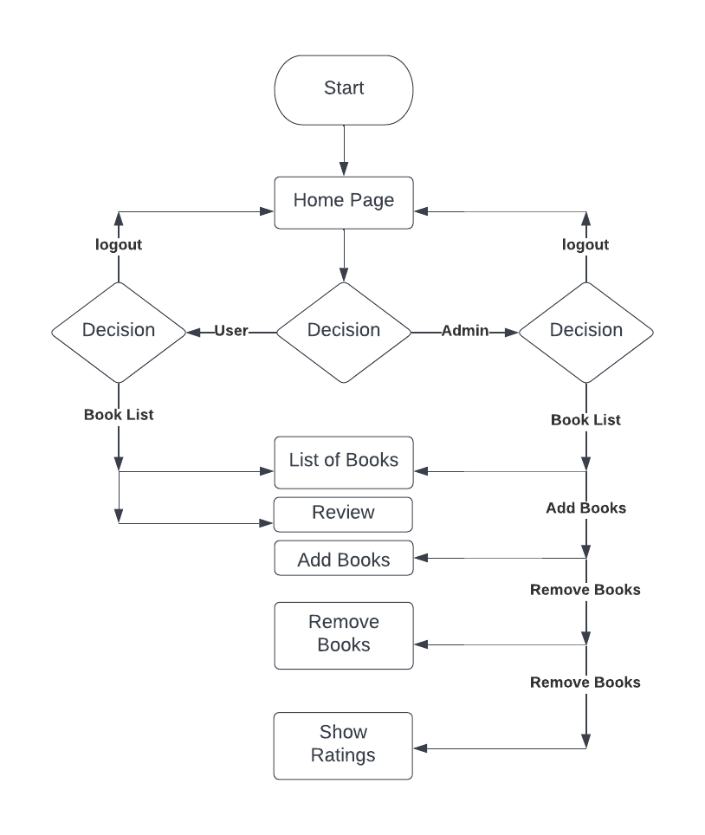
APP Flow
* Flow Chart :-

Slide 7
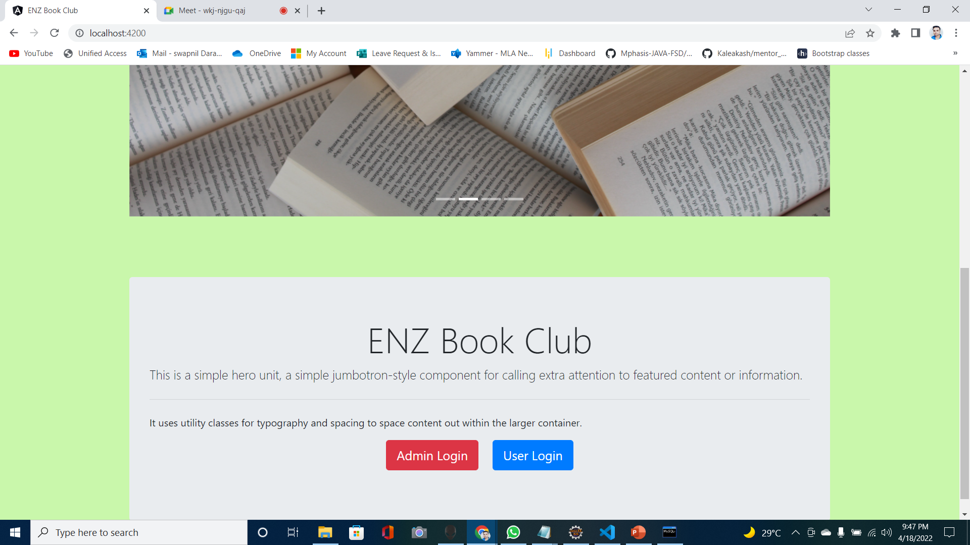
SCREENSHOT: Home Page (dashboard)

Slide 8
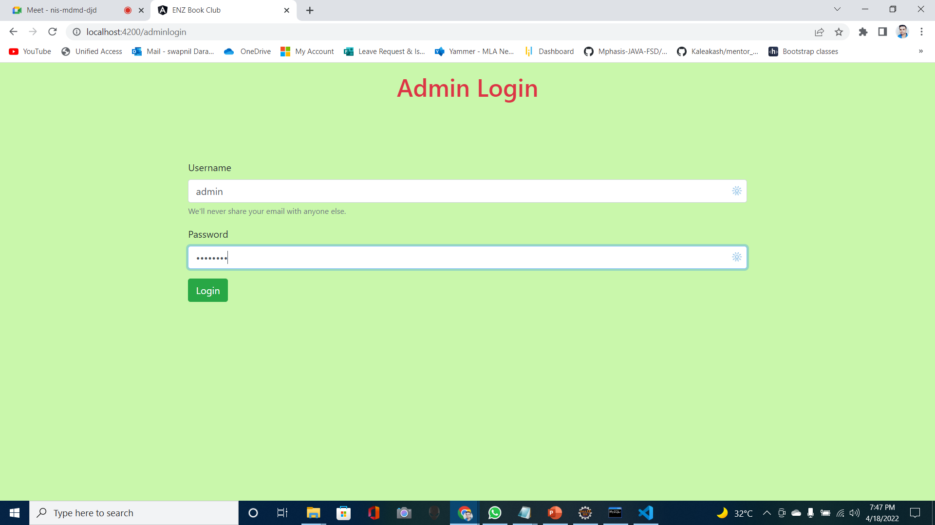
SCREENSHOT: Admin Login

Slide 9
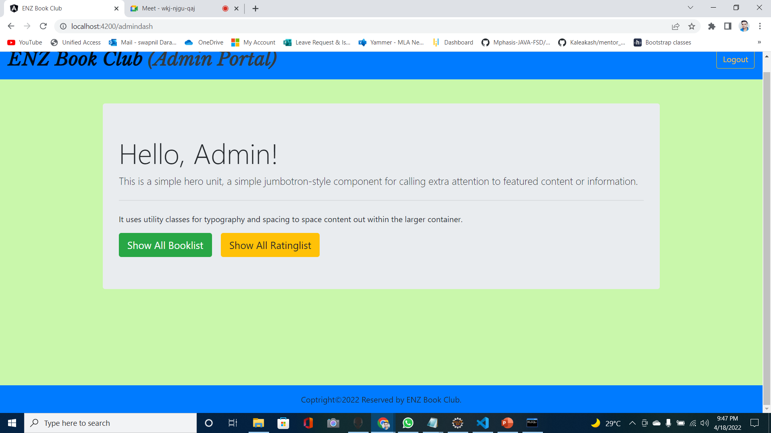
SCREENSHOT: Admin portal

Slide 10
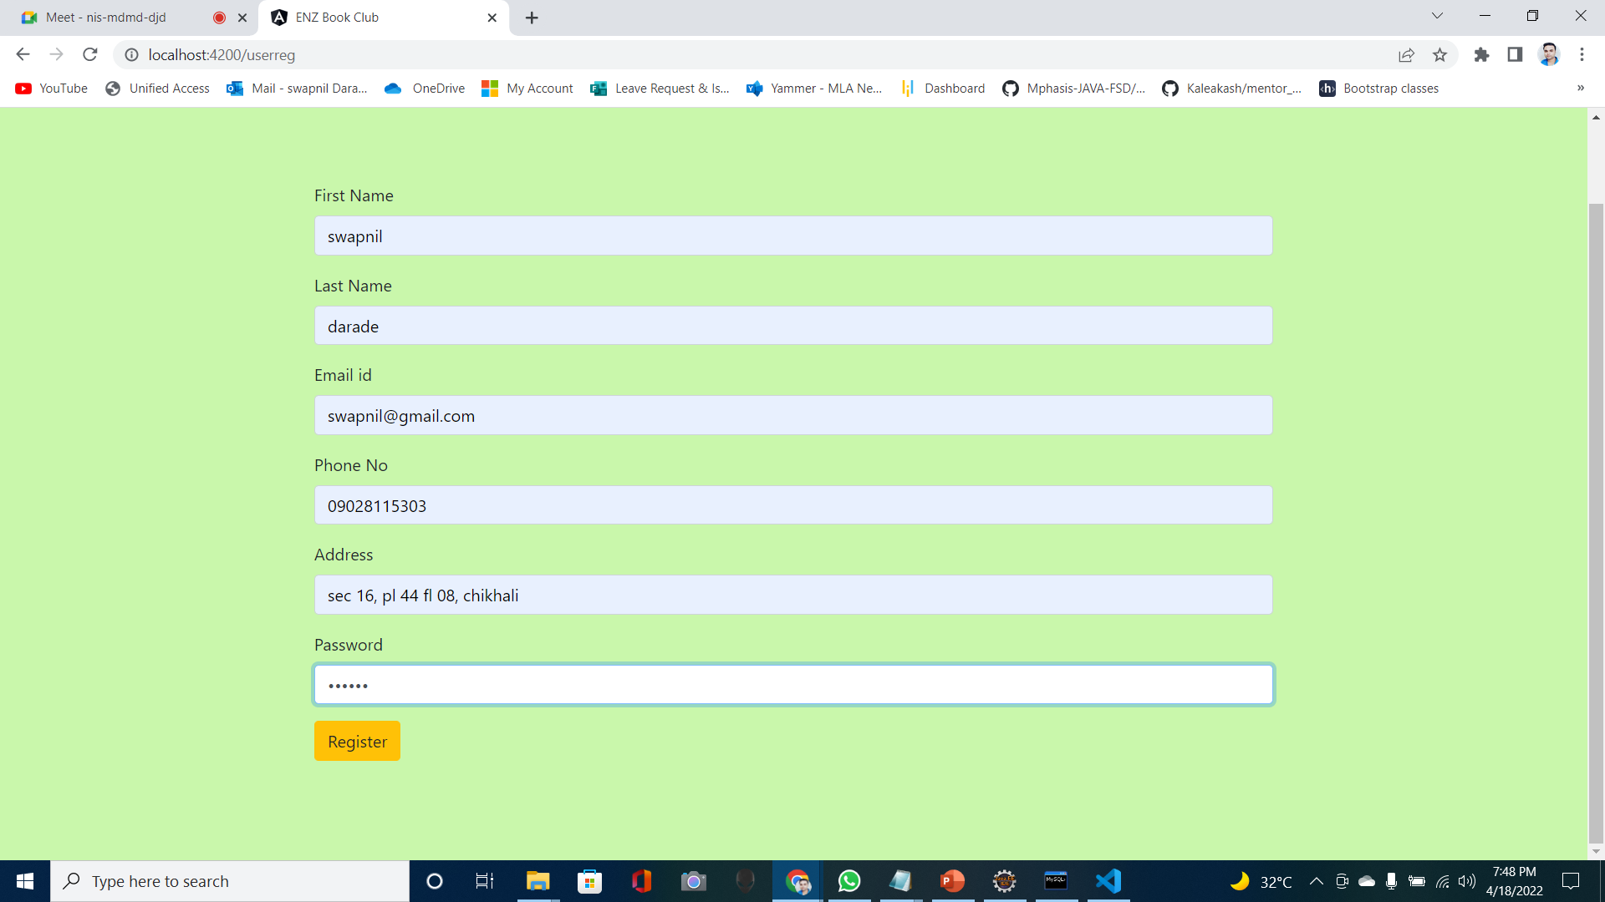
SCREENSHOT: user Registration

Slide 11
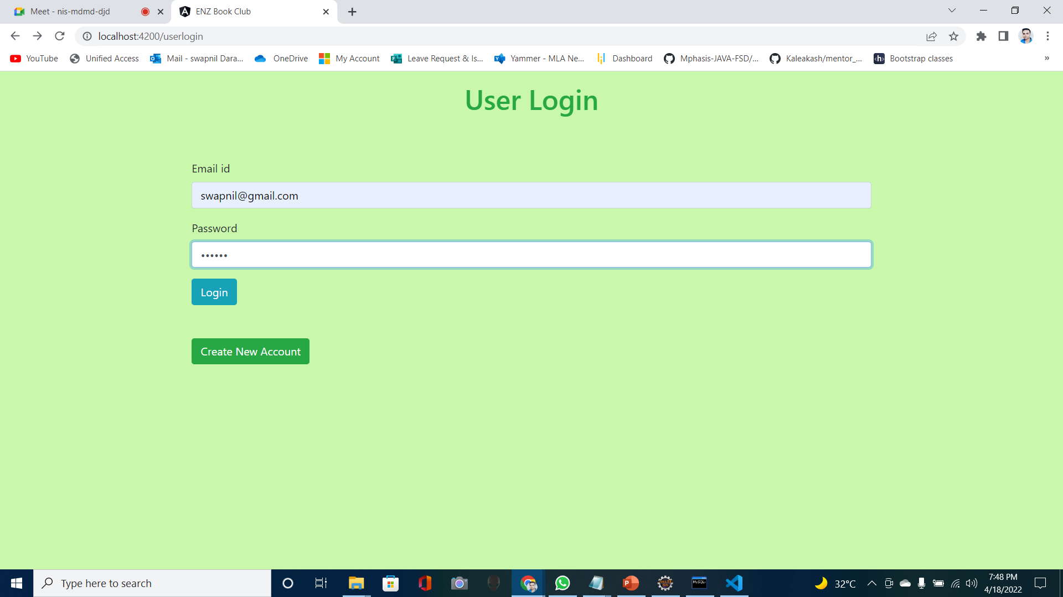
SCREENSHOT: user LOGIN

Slide 12
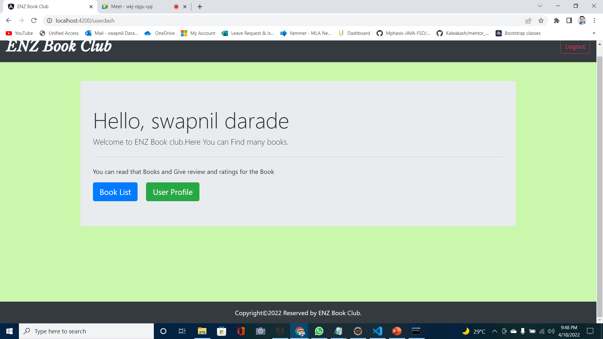
SCREENSHOT: user portal

Slide 13
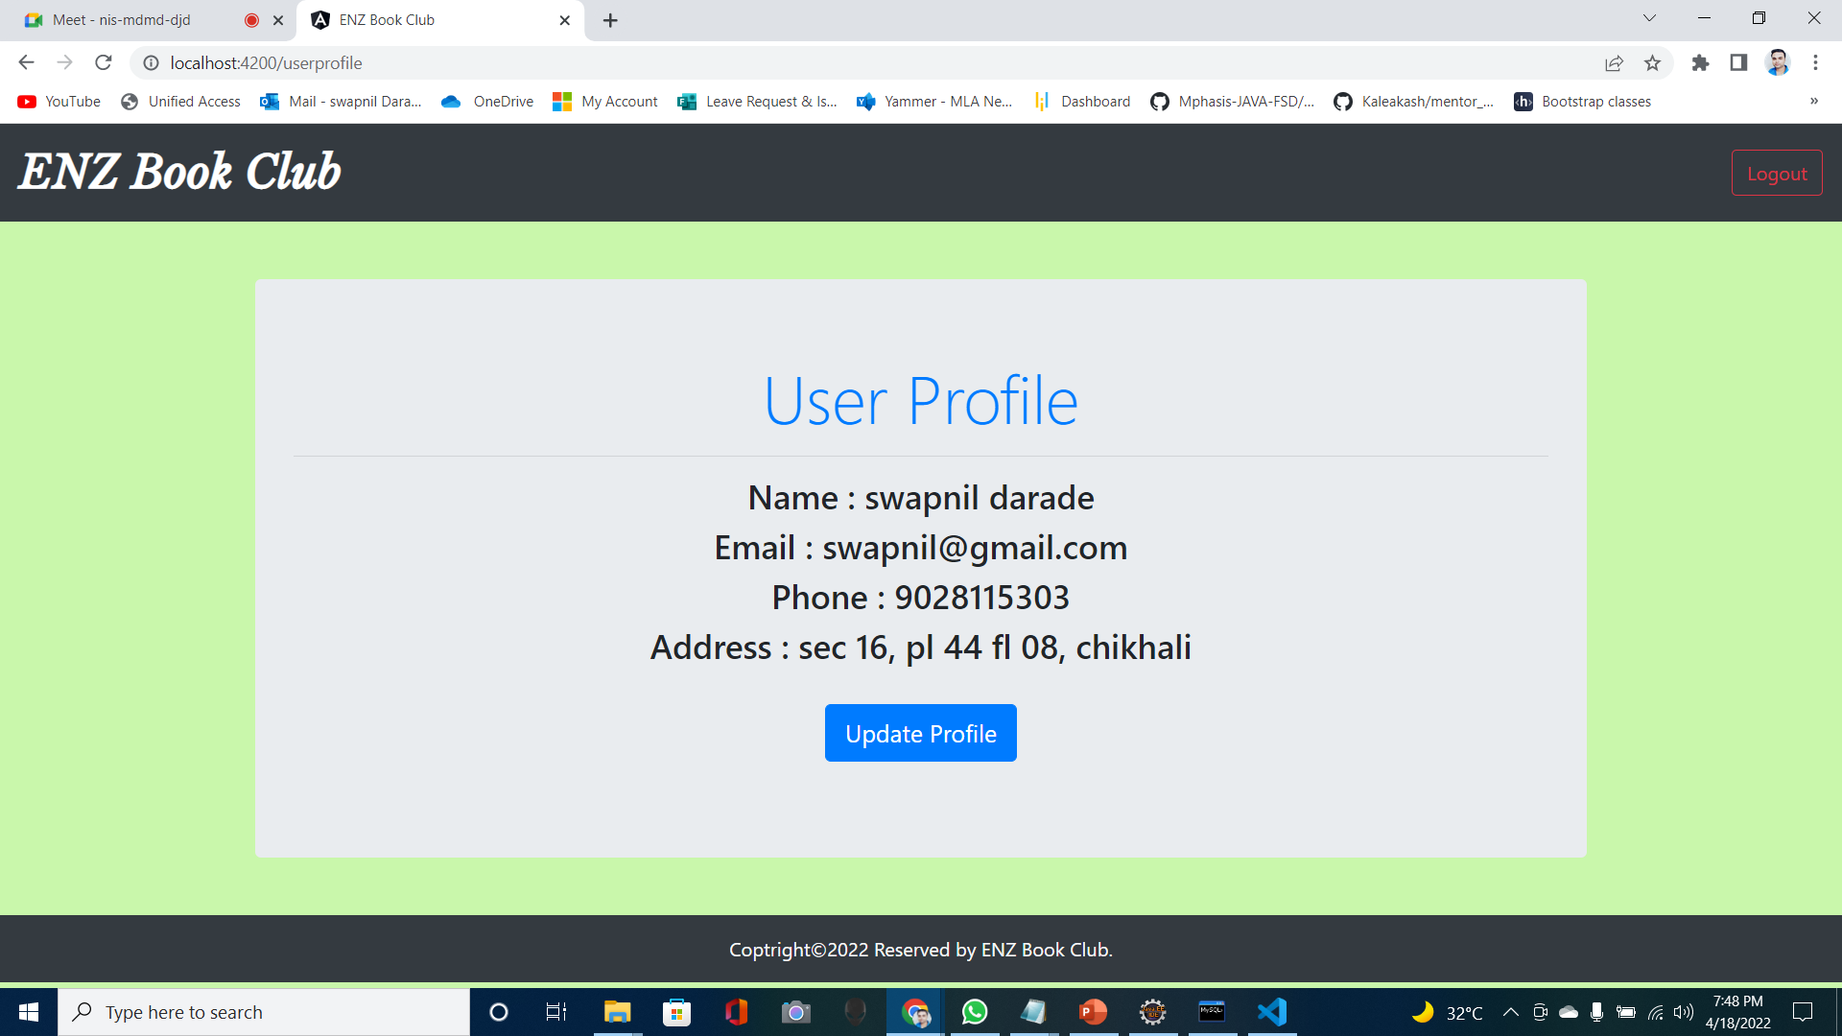
SCREENSHOT: User profile

Slide 14
OUTPUT SCREENSHOT: Create user

Slide 15
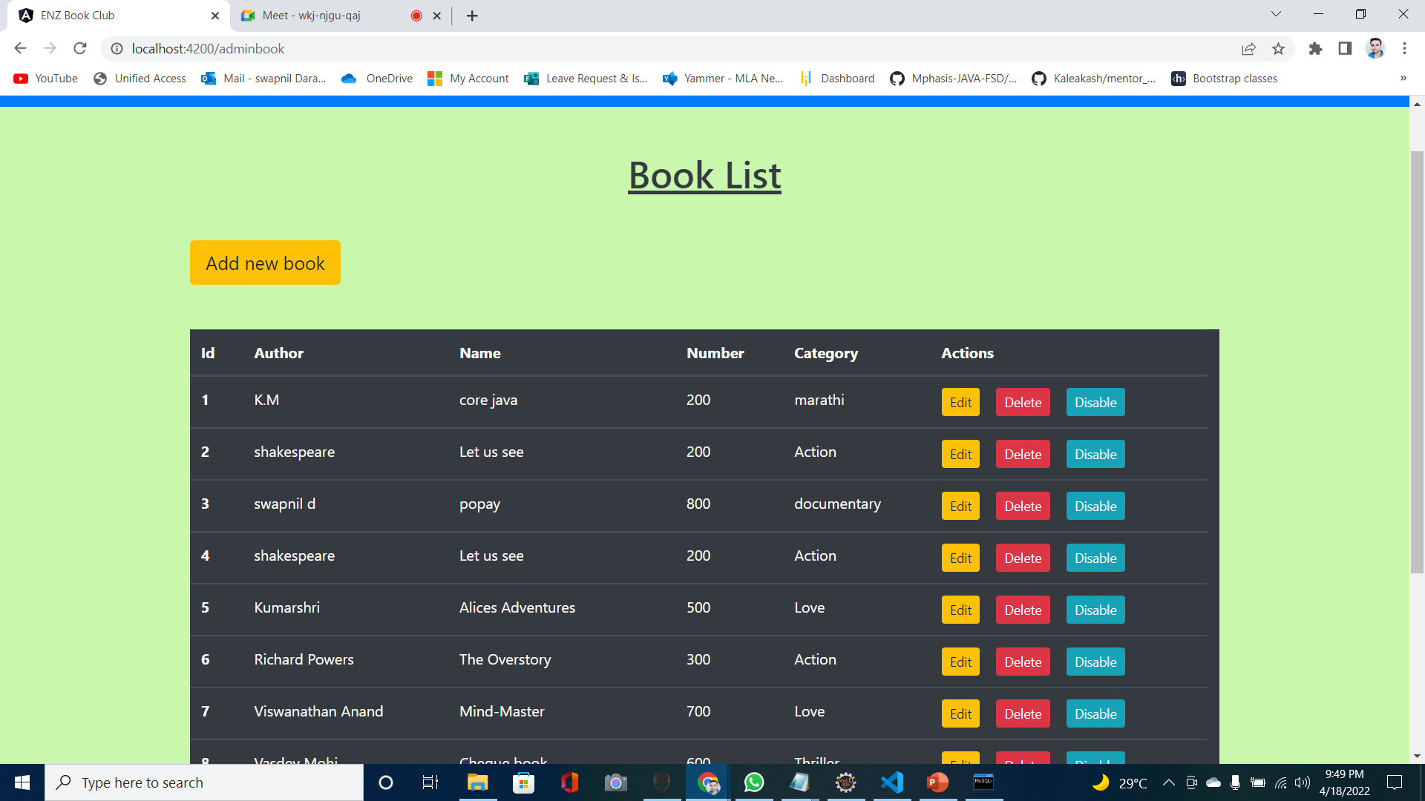
OUTPUT SCREENSHOT: BookList

Slide 16
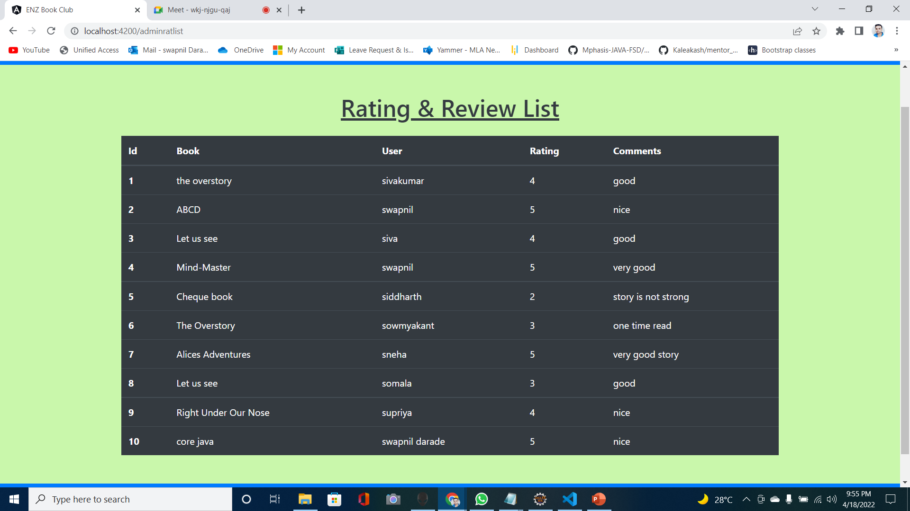
Output: Rating & Review

Slide 17
Features of Book Review system
Store books.
Store User and Admin Details.
We can see the ratings of books.
It is very interactive and saves time.
Easily available.
Reduces paper works.
It is completely controlled by admin.

Slide 18
Future scope and Improvements
Online Book Review System will be useful for reading any book at any location
The system can be developed in such a way that its existing features can be modified to better versions.
We can add audio books also.
It will save time and money
Reading books makes more Efficient.
The book user will increase.
Cloud-Based book Reading Systems are the Wave of the Future.

Slide 19
REFERENCES
www.google.com
www.spring.io
www.stackoverflow.com
www.youtube.com
www.w3Schools.com
www.freeCodeCamp.com

Slide 20
Conclusion
Book Review System shows books details and user details.
It is used to read Books and rate it.
Manage Book details.
Easy-to-use .
Time-saving.
-- THANKYOU EVERYONE --

